Slide 1
Presentation
TEAM A5
Adham Elsaygh-Ali Abdelkhalek-Mohamed Awis-Kirlos Megalli

Slide 2
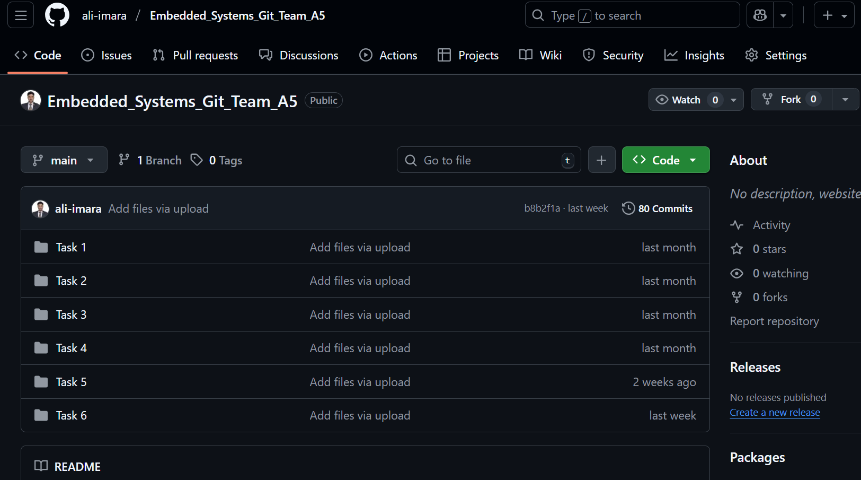
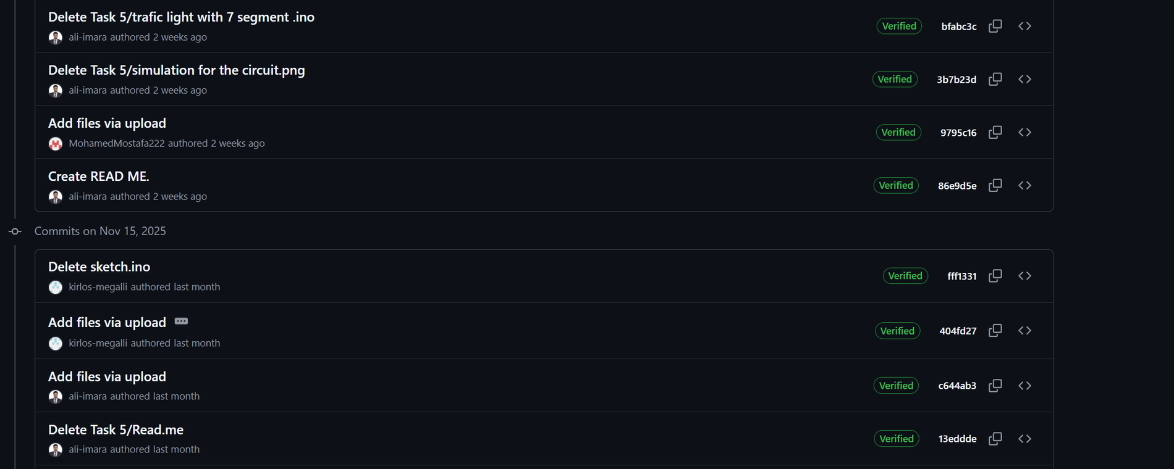
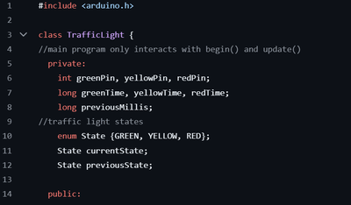
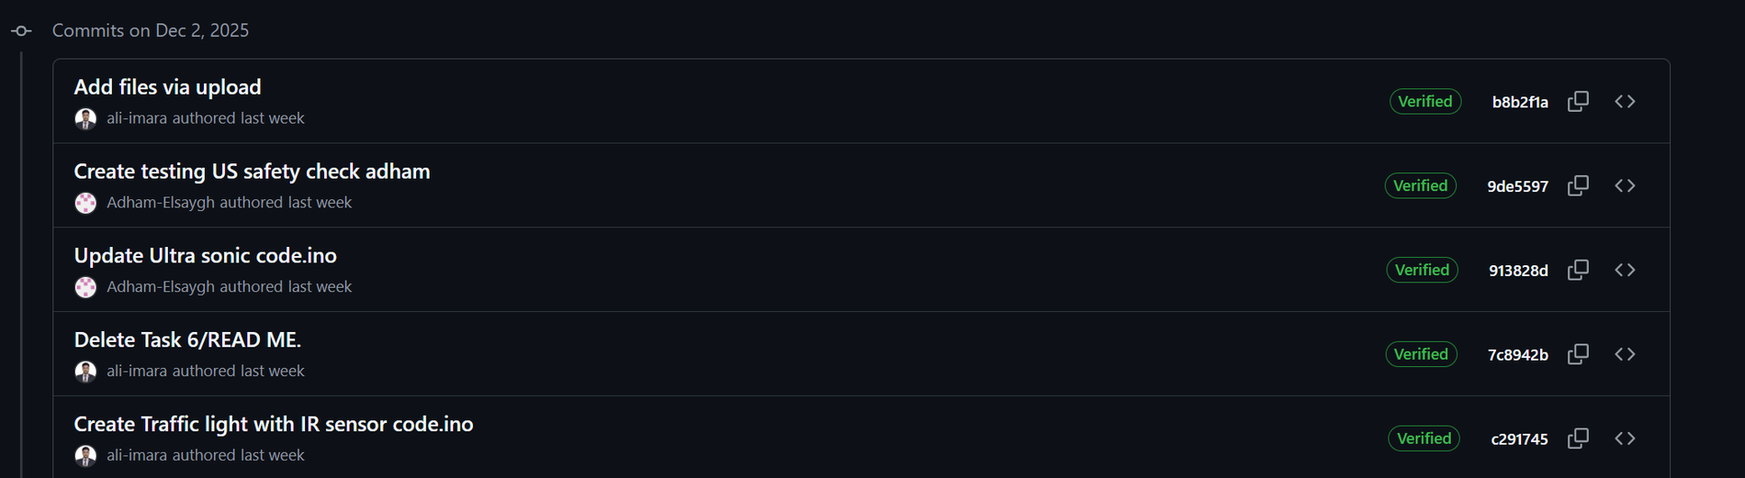
Organisation
Notes:
MENTION FOLDERS,OOP TO MAKE IT MORE PROFFESIONAL AND FOR NEXT OBJECT

Slide 3
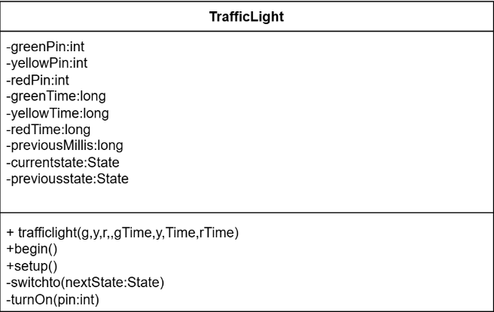
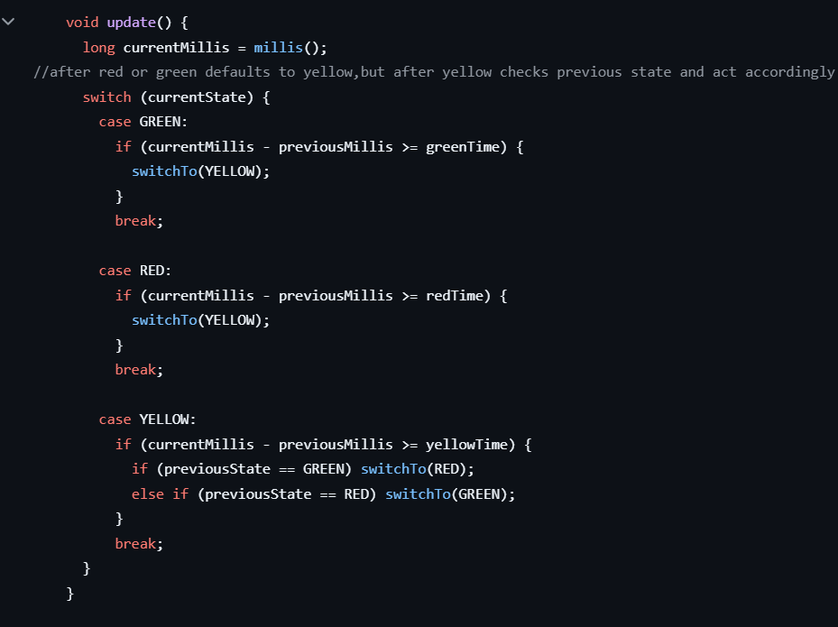
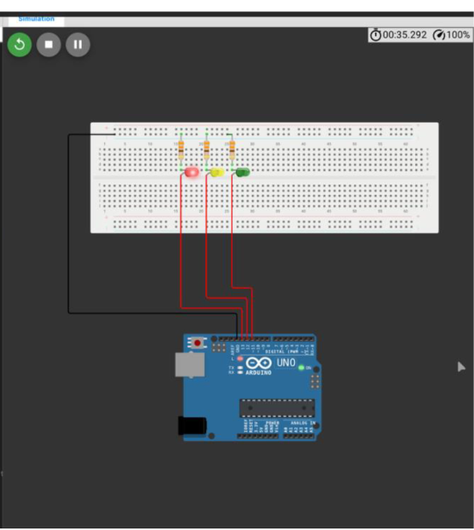
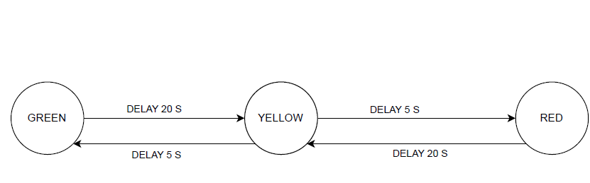
Task 1
Implementation is structured using Object-Oriented Programming (OOP) principles, with the main function detailing execution flow after hardware initialization
Notes:
Briefly explain task,Mention oop usage ,explain main function, state that this is after all pin declarations

Slide 4
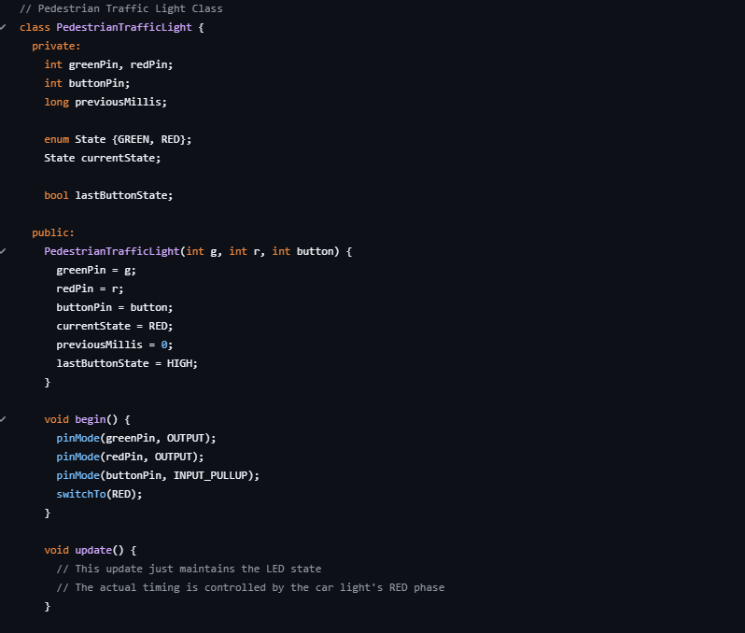
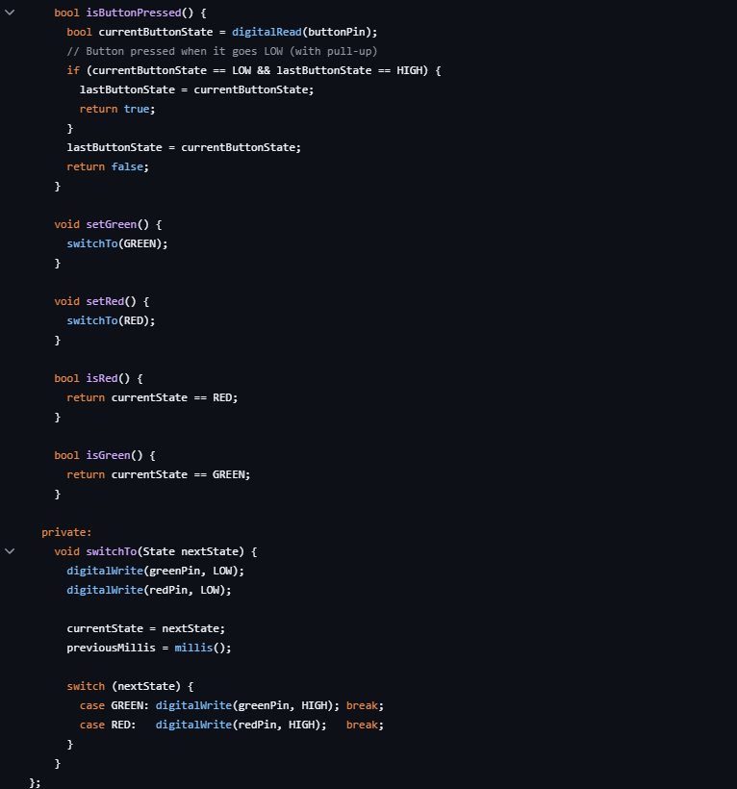
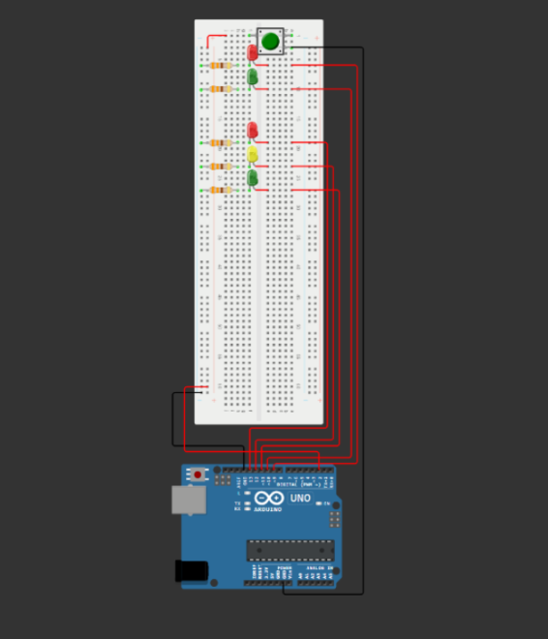
Task 2
A new class was created for the pedestrian traffic light.

Slide 5
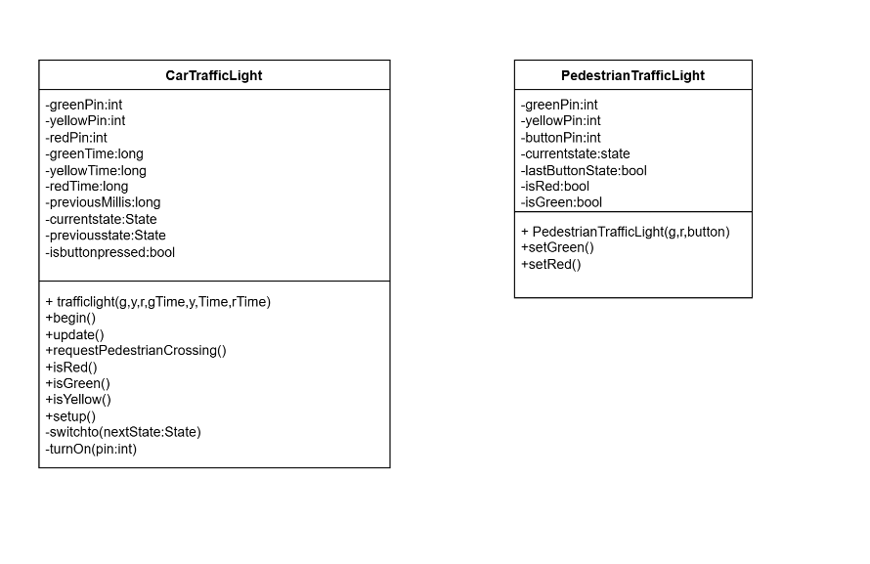
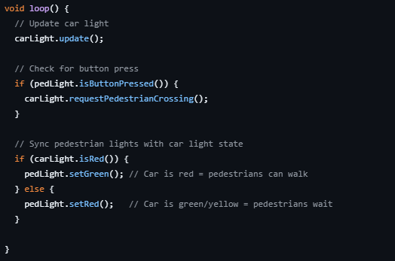
Task 2

Slide 6

Task 3,4
Mapping of task 1 to a (real) Arduino
Mapping of task 2 to a (real) Arduino

Slide 7
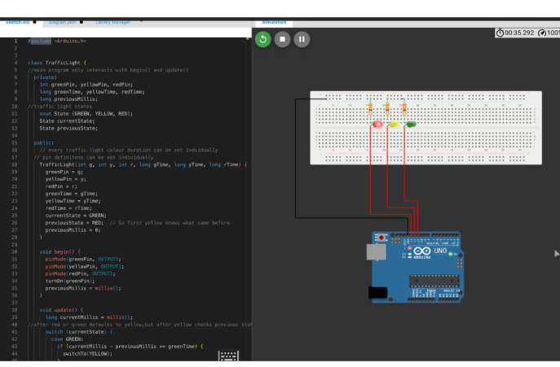
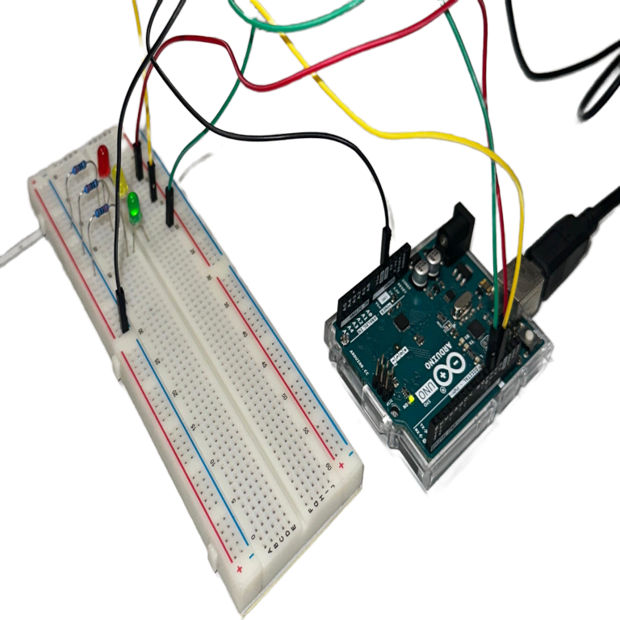
Task 3
The simulation of Task 1 results are consistent with the behavior of the real-life circuit.

Slide 8
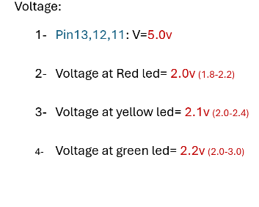
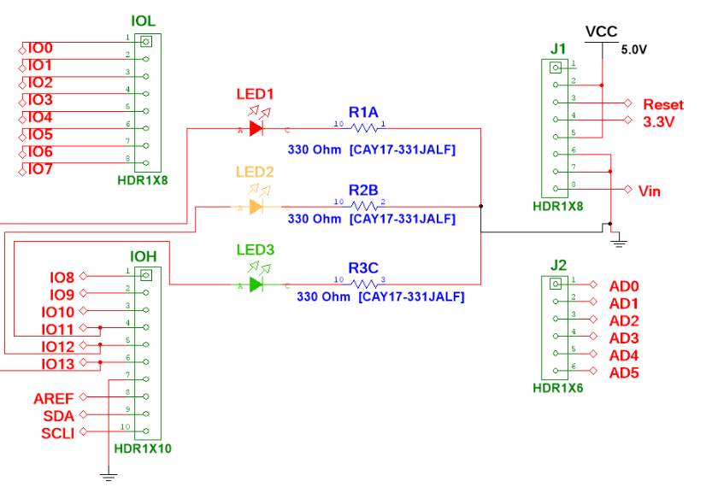
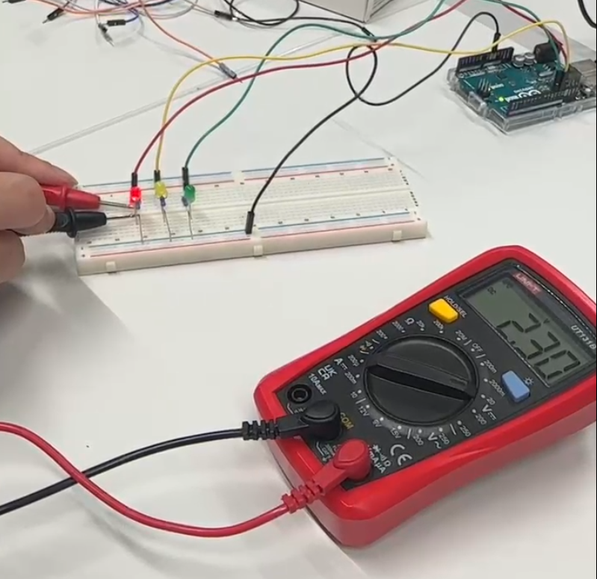
Task 3
The measured voltage from the real red LED closely corresponds to the calculated voltage.
Multisim circuit design
Real life calculation

Slide 9
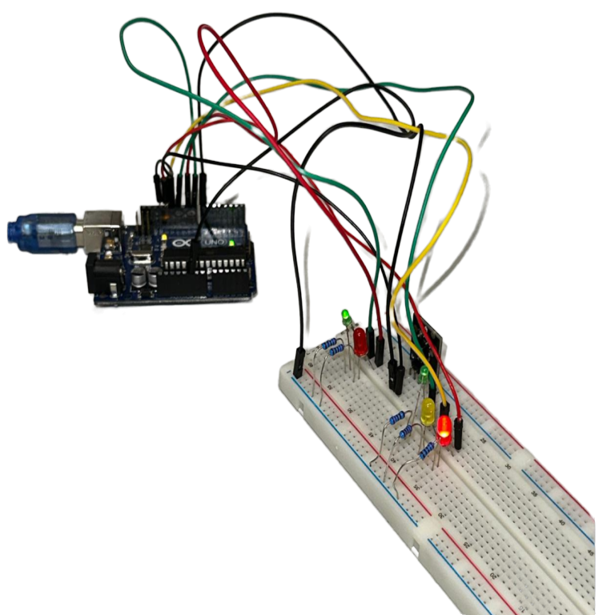
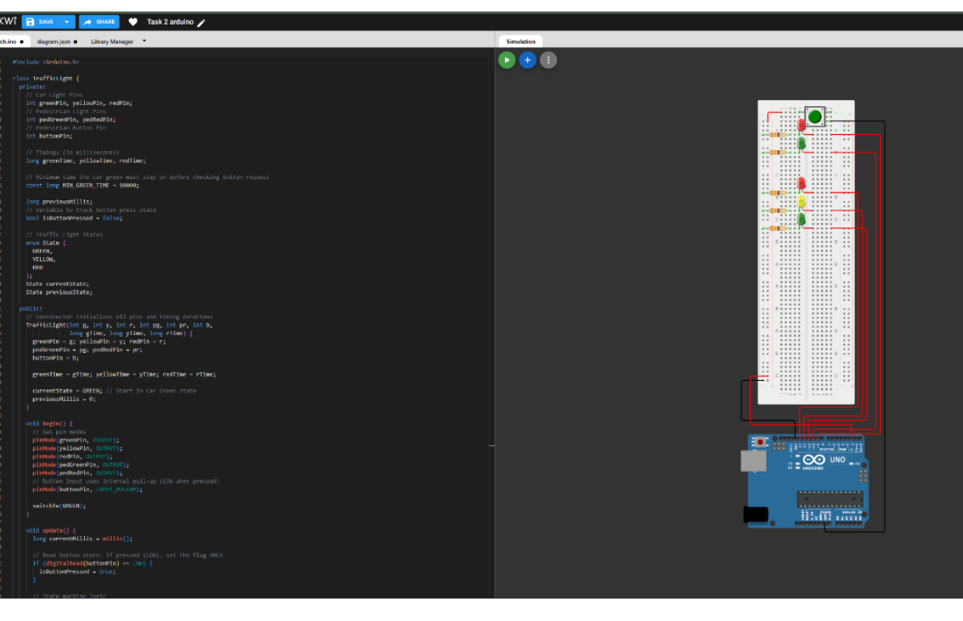
Task 4
The simulation of Task 2 results are consistent with the behavior of the real-life circuit.

Slide 10

Task 5
Connections Techniques to connect µCs

Slide 11
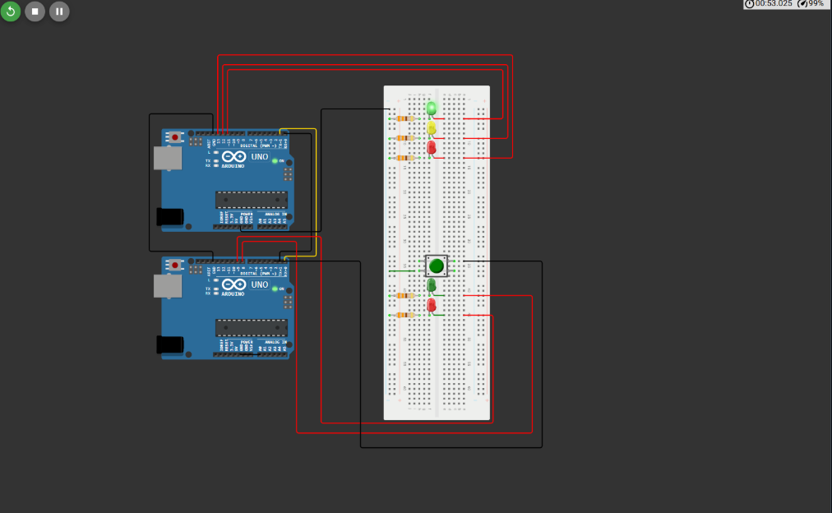
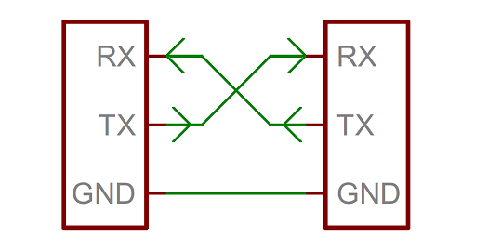
Task 5
Adjusting the circuit from task 4 by adding a second microcontroller, and wiring the two microcontrollers according to the UART wiring.

Slide 12
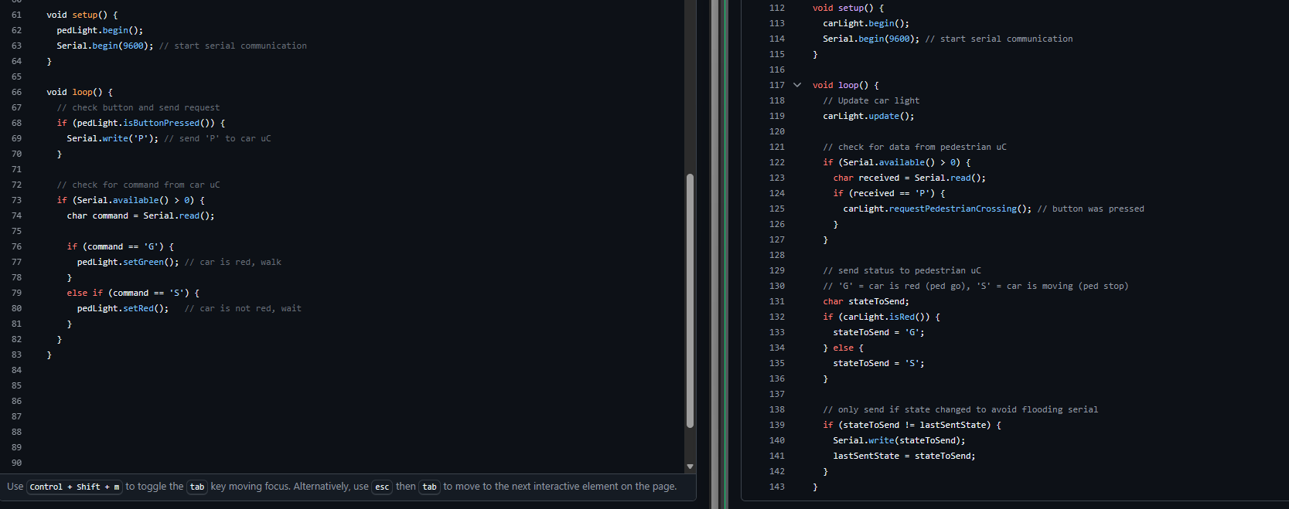
Task 5
Starting the serial communication Between the car traffic light and the pedestrian light

Slide 13
Thanks For Your Attention

